Slide 1

SESSION - 1
INTRODUCTION TO CYBERSECURITY

Slide 2
LEARNING OUTCOMES :
What is cybersecurity?
Describe society’s increasing reliance on electronic devices.
Explain why we all need to be concerned about cybersecurity.
Introduction to cyber threats (hackers, viruses, phishing, etc.).
Why personal and national security matters.
Activity : List daily online activities and identify potential risks associated with them.
Practicals : Conduct a simple experiment where students are asked to create a "strong password" and a "weak password."

Slide 3
WHAT IS CYBERSECURITY?
Cybersecurity refers to the practice of protecting systems, networks, and data from digital attacks.
These attacks are usually aimed at assessing, altering, or destroying sensitive information, extorting money from users, or interrupting normal business processes.
In today's interconnected world, the reliance on technology is greater than ever, which makes cybersecurity crucial for both individuals and organizations.
Example : Imagine you use your smartphone to check your emails, log into social media, and even shop online. Cybersecurity measures ensure that your private information, such as your passwords, credit card details, and personal messages, remains protected from hackers or cybercriminals.

Slide 4
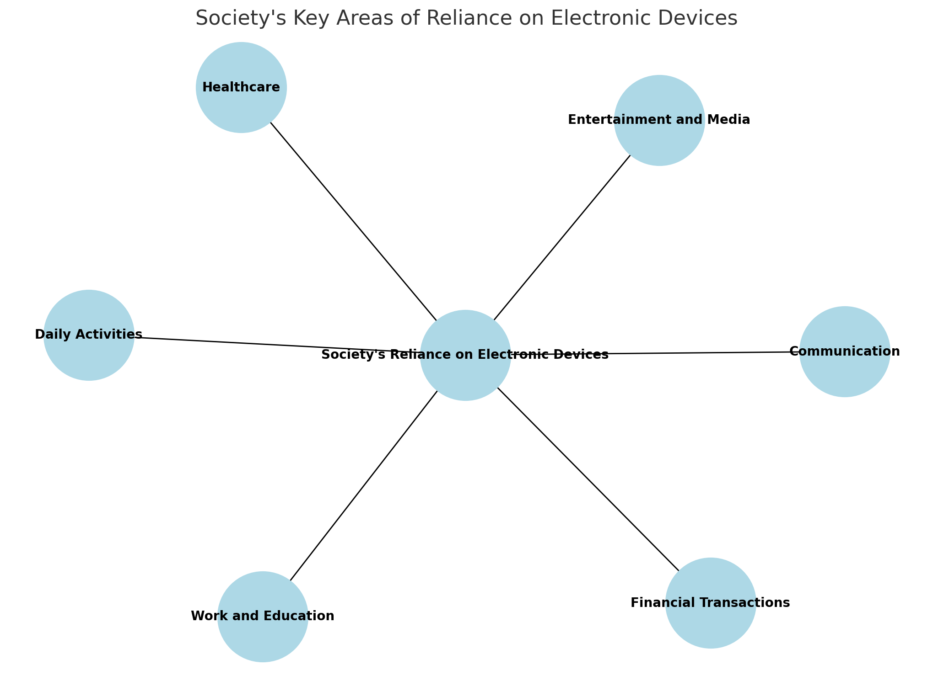
Society’s increasing reliance on electronic devices :
- Communication: Smartphones, tablets, and laptops are essential for communication, connecting people across the globe through social media, messaging apps, video calls, and email.
- Work and Education: Similarly, schools and universities utilize online learning platforms(ZOOM , Microsoft Teams ), digital resources, and educational apps to support learning.
- Daily Activities:. Wearable devices track health and fitness, while smart home systems control lights, security, and appliances.
- Entertainment and Media:. People consume media on their phones and tablets, from movies and music to news and podcasts.
- Healthcare: Electronic devices are transforming healthcare, from telemedicine to wearable health monitors. Electronic Health Records (EHRs) store patient data, allowing easy access and sharing between healthcare providers for efficient diagnosis and treatment.
- Financial Transactions: Banking apps, e-commerce, and digital payment systems like PayPal and UPI make managing finances and making purchases more convenient.

Slide 5
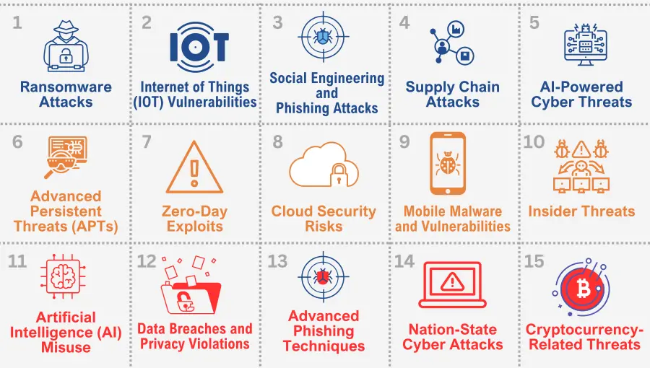
Observe the following table & analyze:

Slide 6
So , from the previous slide we derive that cybersecurity is of utmost importance for the following reasons :
Protection of Sensitive Data
Building & Maintaining Trust
Supporting global security
Preserving Privacy
Preventing Financial Loss
Protecting Personal Privacy
Maintaining Business Continuity
Supporting national security
Reducing cybercrime

Slide 7
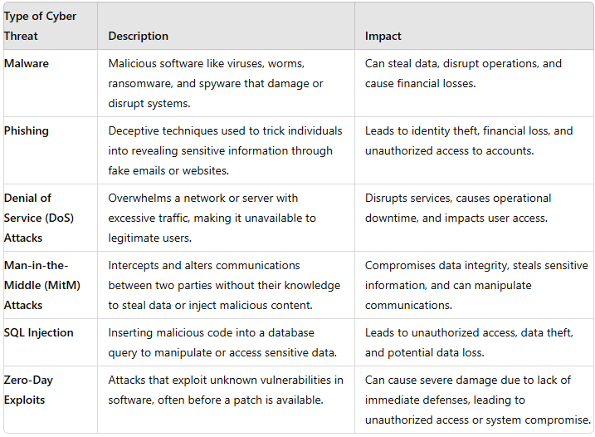
Types Of Cyber Threats :

Slide 8
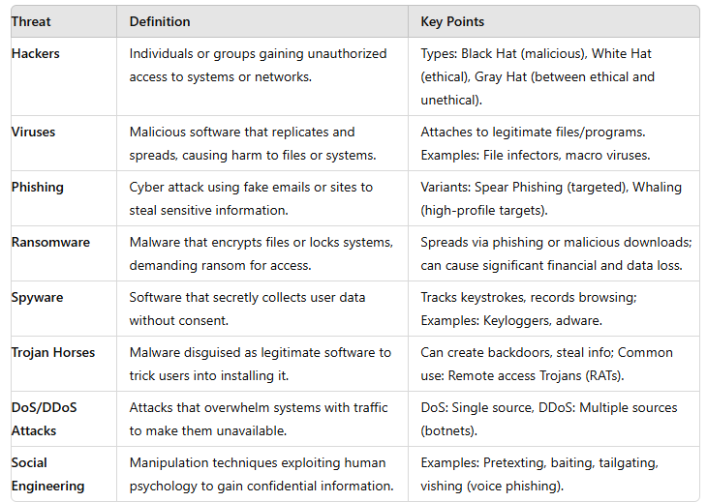
Most Common Cyber Threats:

Slide 9
Understanding Cyber Threats :
Cyber threats are malicious activities that target computer systems, networks, and digital devices with the intent to cause harm, steal data, disrupt services, or gain unauthorized access.
These threats come in various forms and can be orchestrated by individuals, groups, or even state-sponsored actors.
As our reliance on technology grows, understanding cyber threats becomes crucial to protecting personal, organizational, and national security.

Slide 10
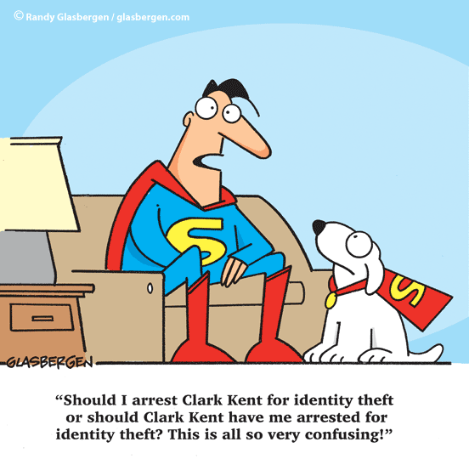
Is my identity at stake ?

Slide 11
Importance of Personal Security
1. Protection of Personal Data : Safeguards sensitive information, such as financial and identity details, from unauthorized access and misuse.
2. Prevention of Cybercrime: Helps protect against cyber threats like identity theft, fraud, and hacking that can have severe financial and emotional impacts.
3. Privacy Preservation : Ensures the privacy of personal communications and activities, preventing exploitation and harm.
4. Peace of Mind : Provides individuals with confidence in using digital services and engaging in online activities safely.
5. Prevents Personal Harm : Protects against threats that could lead to personal loss, emotional distress, or physical harm.

Slide 12
Importance of National Security
1. Protection of Critical Infrastructure : Secures essential systems (e.g., power grids, communication networks) that are vital for societal functioning.
2. Economic Stability : Prevents cyber attacks on financial institutions and businesses that could destabilize the economy.
3. Defense Against Cyber Warfare : Shields the nation from attacks by hostile nations or groups aiming to disrupt or damage national interests.
4. Safeguarding Sovereignty : Protects the nation’s independence by preventing foreign interference in its political and social affairs.
5. Public Safety : Ensures the safety of citizens by preventing terrorism, organized crime, and other large-scale threats.
So, personal and national security are essential for protecting the well-being, privacy, and stability of individuals and the country as a whole, allowing for safe and confident participation in the digital world.

Slide 13
CASE - STUDY

Slide 14
Case Study:
Background: Riya , a Grade 8 student, spends a lot of time online. She enjoys browsing social media, playing online games, and watching videos. Recently, she encountered a few issues related to her online activities.
Scenario:
Social Media: Riya frequently posts pictures of her vacations and other personal activities on social media. She has a large number of friends, including some she doesn’t know personally.
Gaming: Riya plays an online multiplayer game where she has made several friends. She often shares her username and talks about her location and daily life with these friends.
Emails: Riya received an email offering free in-game currency for her favorite game. The email had a link asking her to confirm her account information to claim the prize.
Downloads: Riya wanted to download a new game that wasn’t available in her usual app store, so she downloaded it from an unofficial website.
Public Wi-Fi: While at a café with free Wi-Fi, Riya logged into her online banking account to check her balance.

Slide 15
Questions
What are the potential risks associated with Jessica’s social media activity?
How could sharing personal information with online friends in a gaming environment pose risks for Jessica?
What are the potential dangers of clicking on links in unsolicited emails offering free prizes?
What risks did Jessica face by downloading a game from an unofficial website?
Why is it risky to use public Wi-Fi for accessing sensitive information, such as online banking?

Slide 16
Practical Study

Slide 17
Strong Password / Weak Password :
Ask each student to create one "strong password" and one "weak password."
Write down their passwords (you can use a safe way for students to show the instructor without exposing passwords to others, like writing on a piece of paper / notepad ).
Use Online Password Strength Testers:
Demonstrate how to use an online tool (like How Secure Is My Password?) to check how long it would take for each password to be cracked.
Password Tester | Test Your Password Strength | Bitwarden
Password Strength Tester (pmdn.org)
password-strength-checker · GitHub Topics · GitHub
Input examples of strong and weak passwords and discuss the results shown by the tool (e.g., how long it would take to crack each password).

Slide 18
1.Which of the following is not considered a form of malware?
A) Virus
B) Worm
C) Firewall
D) Trojan

Slide 19
2. What does "phishing" primarily aim to do?
A) Encrypt files on a target's system
B) Steal personal information
C) Generate spam emails
D) Perform a DDoS attack

Slide 20
Which one of these is an input device?
A) Monitor
B) Keyboard
C) Printer
D) Speakers

Slide 21
What is the primary purpose of a firewall in a computer network?
A) To scan for viruses
B) To prevent unauthorized access
C) To manage system resources
D) To encrypt data

Slide 22
Which type of malware encrypts files and demands a ransom to restore access?
A) Spyware
B) Adware
C) Ransomware
D) Rootkit

Slide 23
Thank - You !

